Slide 1
Angular – Week 3
Components
Lifecycle hooks
Modules
Routing

Slide 2
Components
In Angular, a component is a basic building block of the user interface. It consists of a TypeScript class that interacts with the HTML view and the application logic.
The structure of an Angular component typically includes the component class, an HTML template, and styles.

Slide 3
Creating a Component
To create a component in Angular, follow these steps:
Open your terminal or command prompt and navigate to your Angular project’s root directory.
Run the following command to generate a new component:
ng generate component <my-component >
Replace my-component with the desired name for your component.
Angular CLI will generate the necessary files and folders for your component, including the template, class, and spec files.
Open the generated component files (my-component.component.html, my-component.component.ts, and my-component.component.css) to start working with your component.

Slide 4
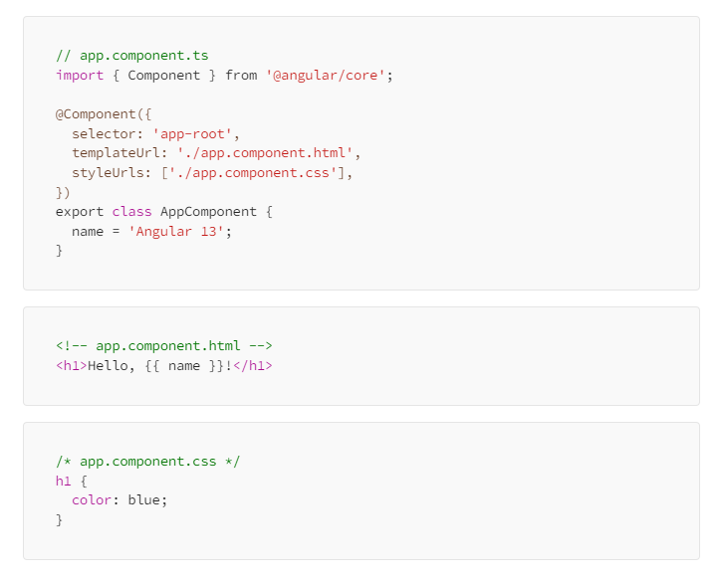
Understanding Component Structure

Slide 5
Interaction between Parent & Child Component
In angular parent-child communication is commonly used to share data between two components.
Here is the structure it follows:
<parent-component> <child-component></child-component> </parent-component>

Slide 6
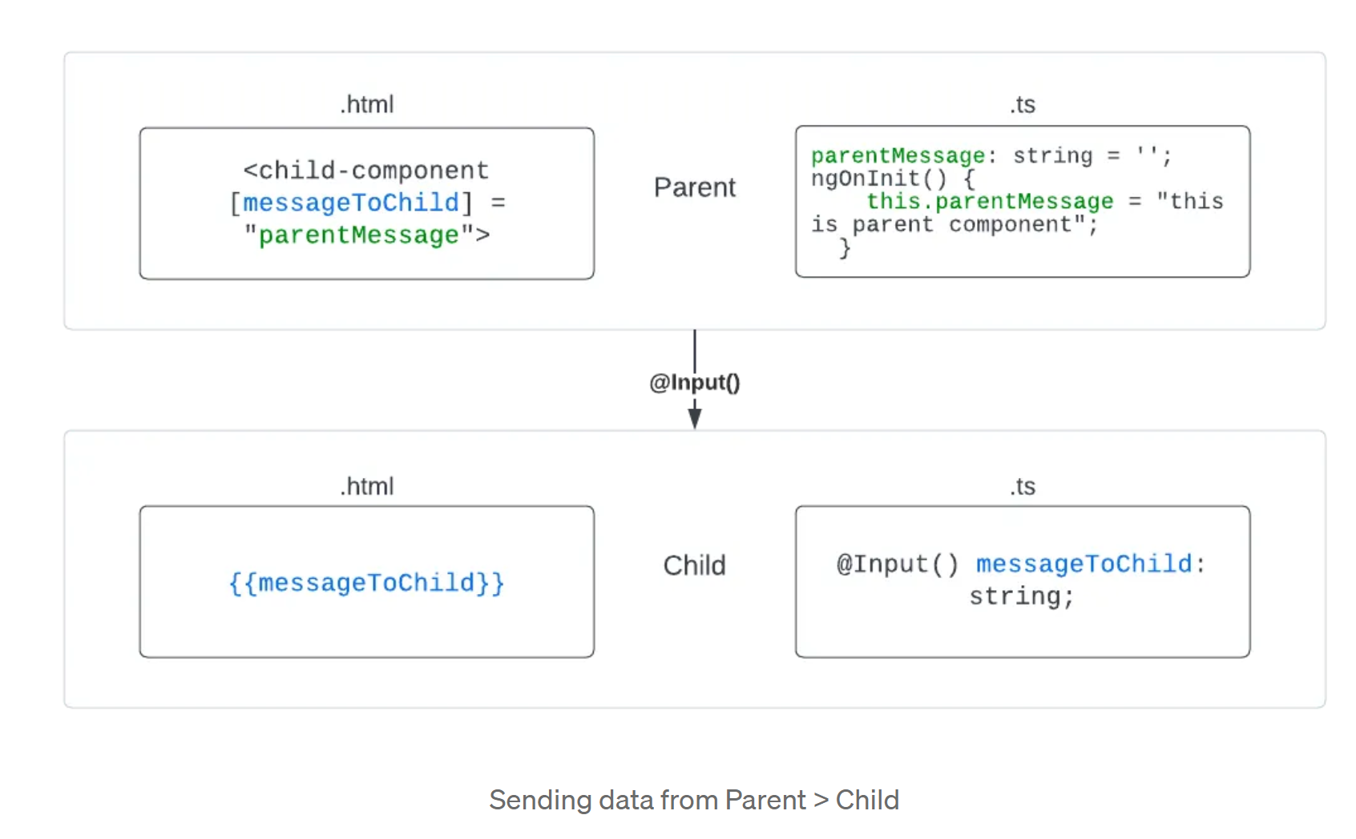
Interaction between Parent & Child Component
Sending data from Parent to Child
@Input — we use this decorator in a child component or directive to signify that the property can receive its value from its parent component.

Slide 7
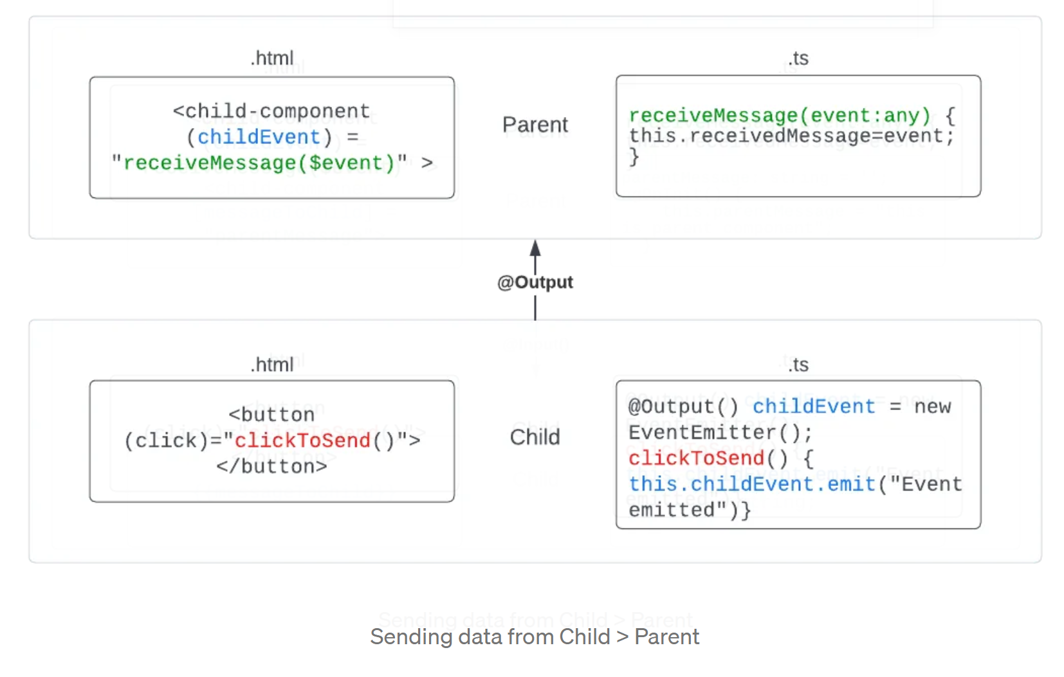
Interaction between Parent & Child Component
Sending data from the Child to the Parent
@Output — marks a property in a child component as a doorway through which data can travel from the child to the parent and it notifies the parent that an event has been raised.

Slide 8
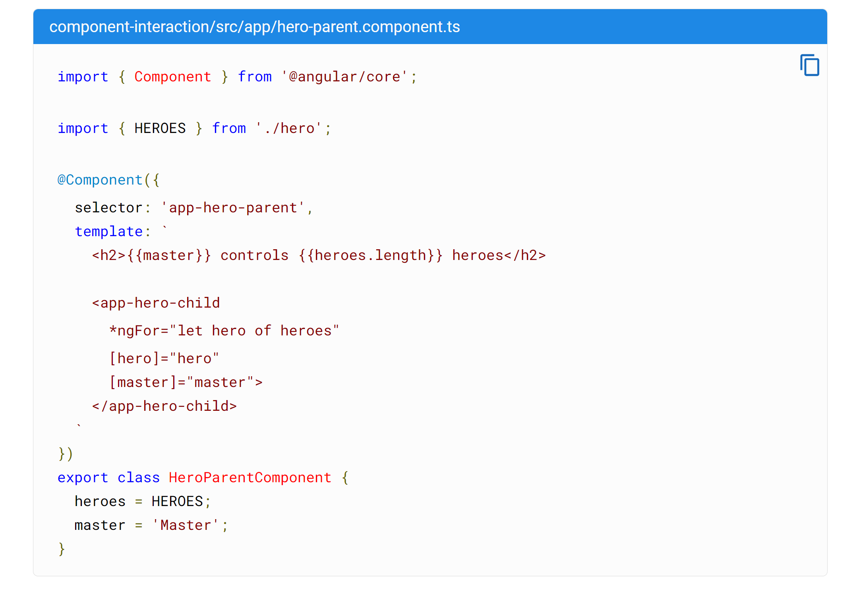
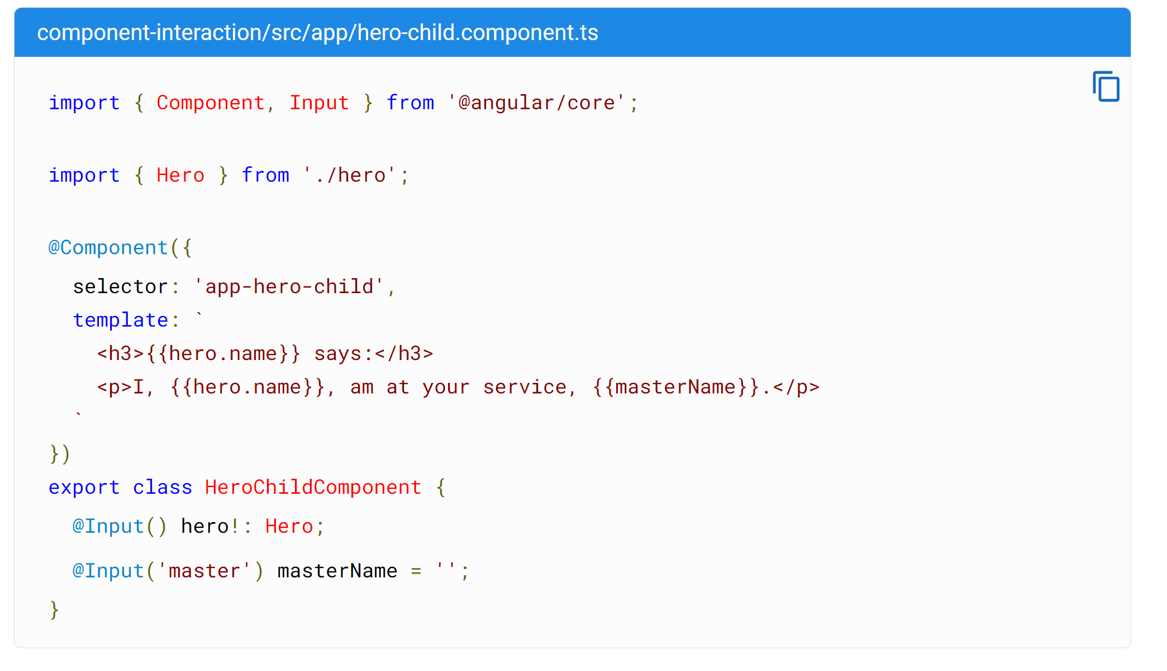
Interaction between Parent & Child Component

Slide 9
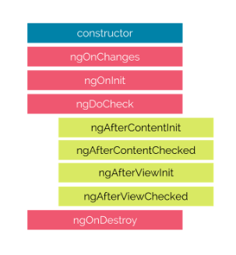
Lifecycle Hooks
A component instance has a lifecycle that starts when Angular instantiates the component class and renders the component view and its child views. The lifecycle continues with change detection, as Angular checks when data-bound properties change and updates both view and component instances as needed.

Slide 10
Lifecycle Hooks
ngOnChanges()
The ngOnChanges hook is called when one or more input properties of a component change. Updating your component's state is made convenient by responding to input changes.
ngOnInit()
Called once the component is initialized.
ngDoCheck()
Called during every change detection run.
ngAfterContentInit()
Called after content (ng-content) has been projected into the component.
ngAfterContentChecked()
Called after every check of component content.
ngAfterViewInit()
Called after the component’s view (and child views) are initialized.
ngAfterViewChecked()
Called after every check of a component's view.
ngOnDestroy()
Called once the component is about to be destroyed.

Slide 11
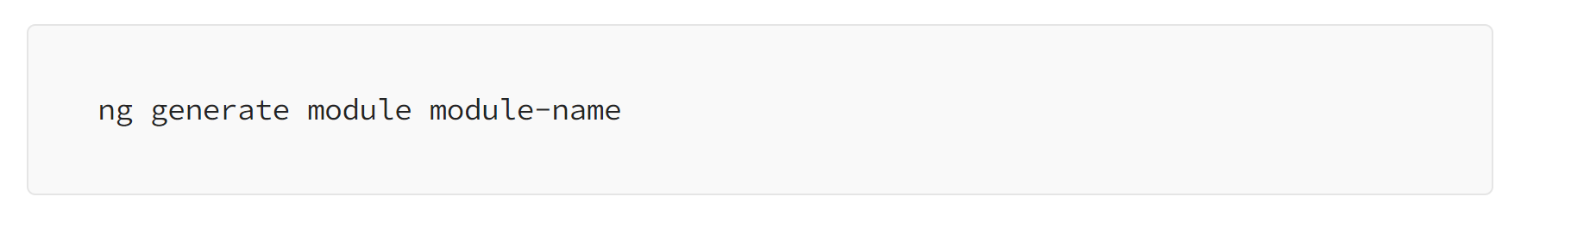
Angular modules
Angular defines modules as a metadata object that describes how to compile a component’s template and how to create an injector at runtime. In other words, a module is a group of components, directives, pipes, and services that you want to make available in parts of your Angular application.
Creating Angular Modules
Angular CLI simplifies module creation. To generate a new module, use the following command:
Defining a Module
You can define a module by importing NgModule decorator from @angular/core and passing a config with components, directives, pipes, and services that you want to use.

Slide 12
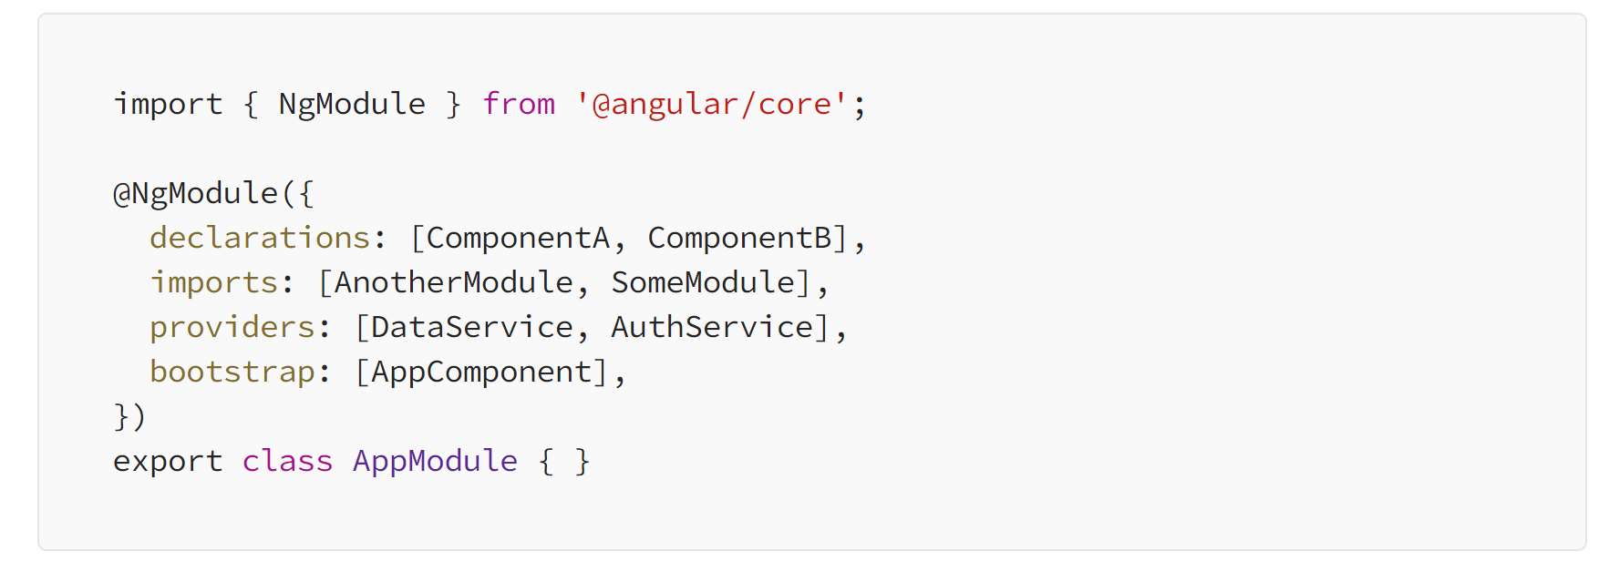
Anatomy of an Angular Module
A typical Angular module includes:
Module Class: Contains the module configuration, including declarations (components, directives), imports (other modules), providers (services), and bootstrap (the root component).

Slide 13
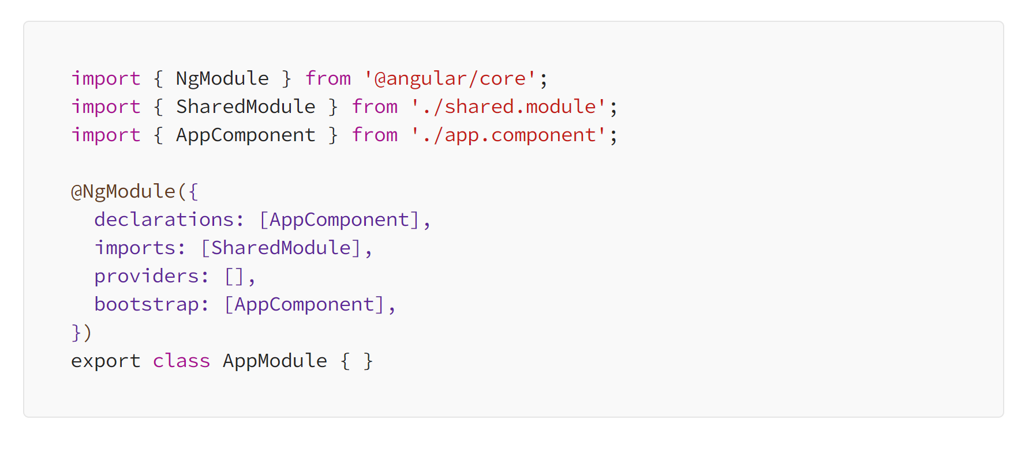
Examples of Angular Modules
Example 1: Creating a Simple Module

Slide 14
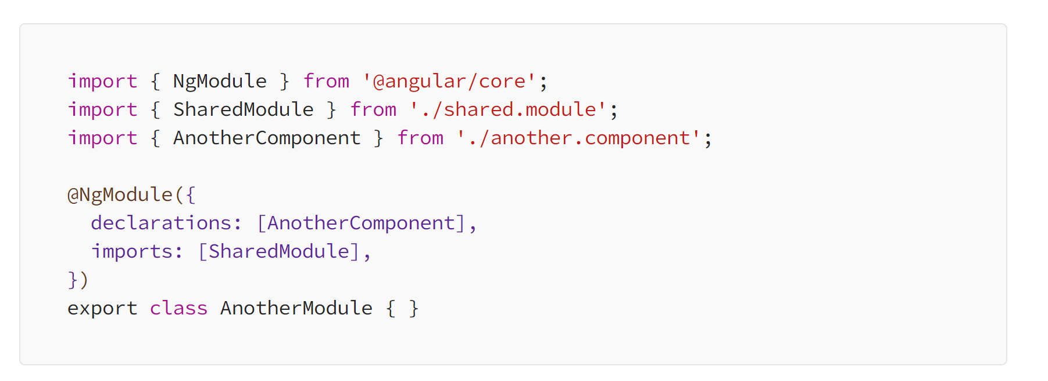
Examples of Angular Modules
Example 2: Importing a Module

Slide 15
Angular Routing
Routing in Angular is a fundamental concept that allows you to build single-page applications (SPAs) with multiple views or pages, all within a single HTML page. It enables navigation between different components or views while maintaining the application state.
Routing in Angular typically involves the following components:
Routes: Routes define the mapping between the URL path and the corresponding components to be rendered.
Router: The router is responsible for interpreting the current URL and loading the appropriate components based on the defined routes.
Router Outlet: The router outlet is a placeholder in the application’s template where the content of the current route is rendered.
Router Links and Navigation: Links and navigation elements, such as anchor tags (<a>) or buttons, are used to trigger navigation to different routes within the application.

Slide 16
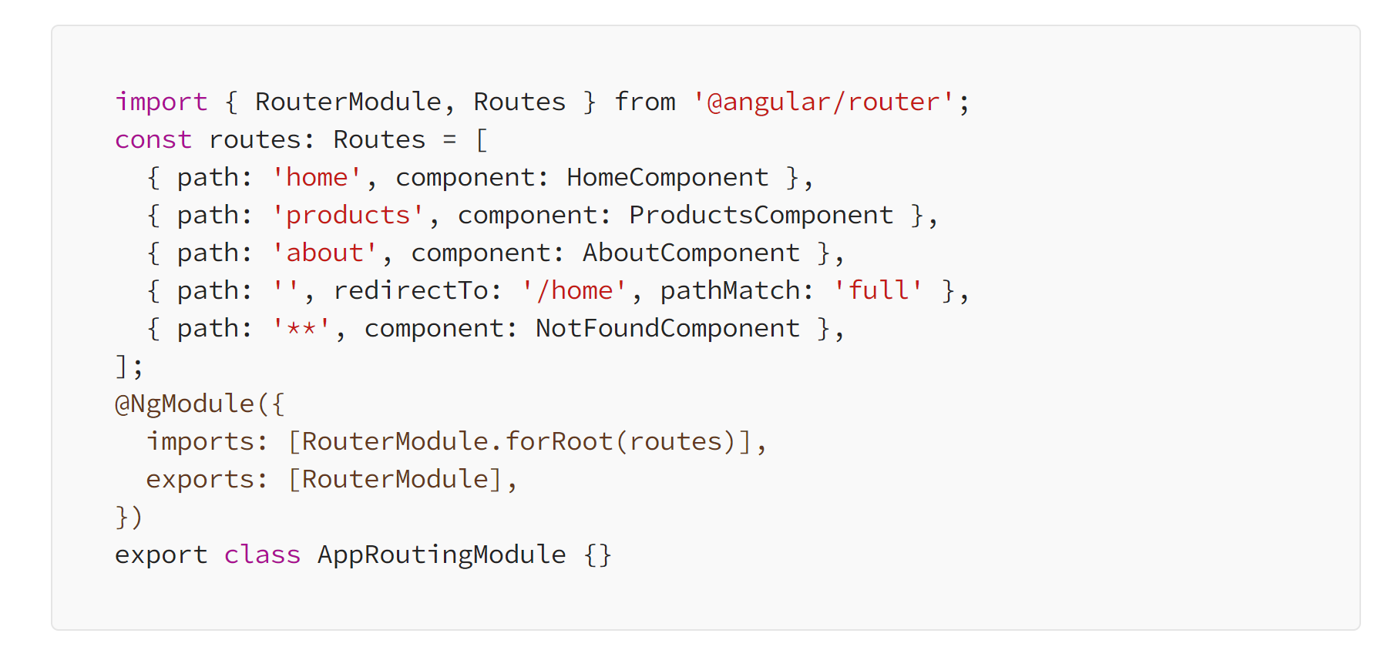
Setting Up Routes
RouterModule:
To enable routing in your Angular application, you need to import the RouterModule and configure it in your main app module.
In this example, an array of route configurations is defined. Each configuration specifies a route path and the component to display when the route is activated. You can also define redirects and a wildcard route for handling unknown paths

Slide 17
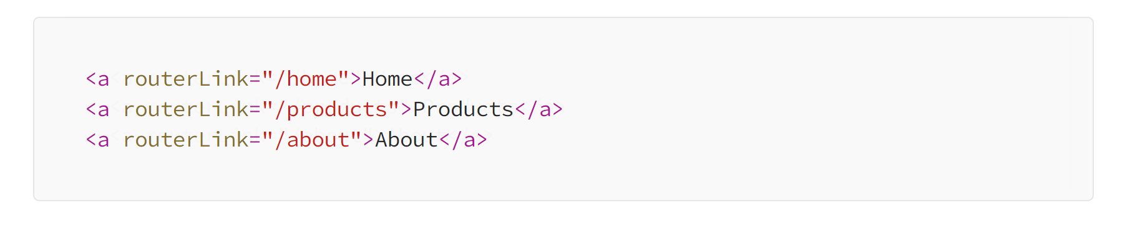
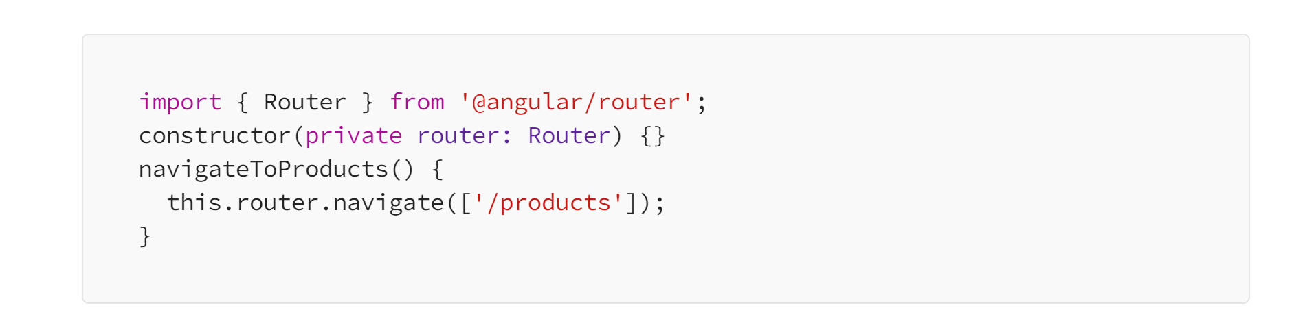
Setting Up Routes
Router Outlet:
To render components associated with routes, you need to add a <router-outlet></router-outlet> element in your main app component's template. This is where the activated component will be displayed.
Navigating Between Routes:
You can navigate to different routes using the RouterLink directive in your templates.
Programmatically, you can use the Router service for navigation in component code.

Slide 18
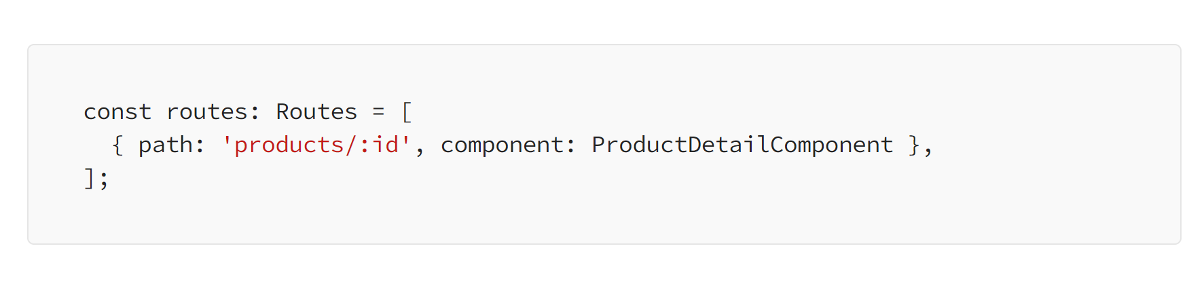
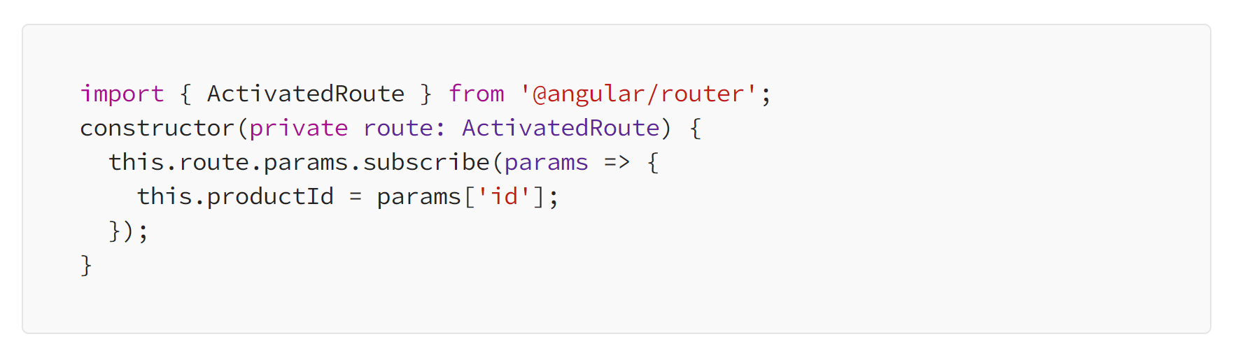
Setting Up Routes
Route Parameters
Routes can have parameters to pass data between components. You define route parameters in the route configuration.
Access route parameters in a component using ActivatedRoute.

Slide 19
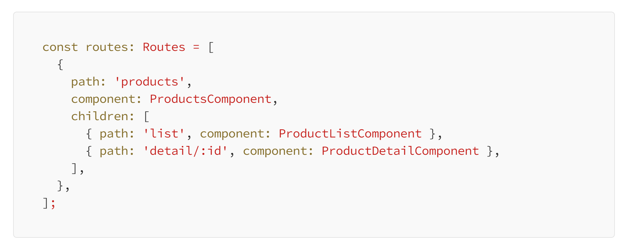
Setting Up Routes
Child Routes
You can create nested or child routes to organize your application’s routes hierarchically.

Slide 20
Thank you

